Slide 1
Dynamic Programming
CSE 2202: Algorithm Analysis and Design Laboratory
Most. Kaniz Fatema Isha
Md Mehrab Hossain Opi

Slide 2
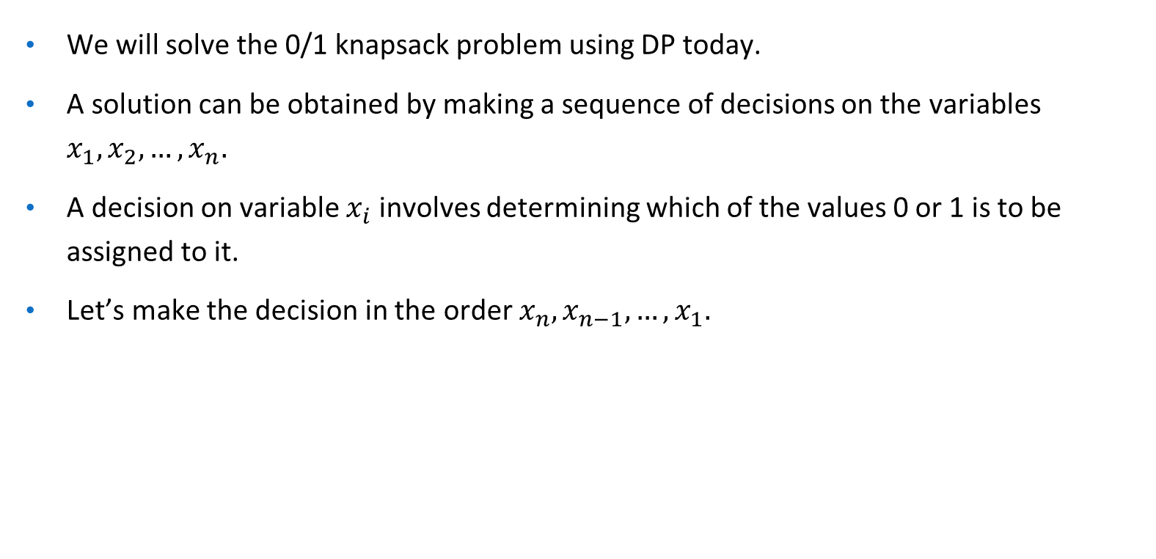
0/1 Knapsack Problem

Slide 3
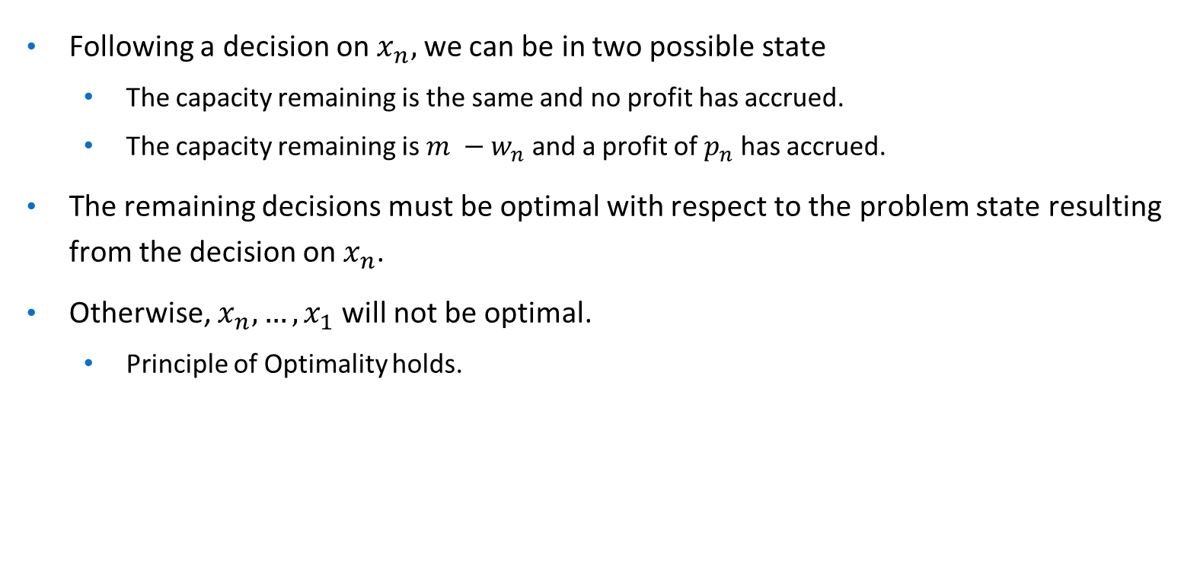
0/1 Knapsack Problem

Slide 4
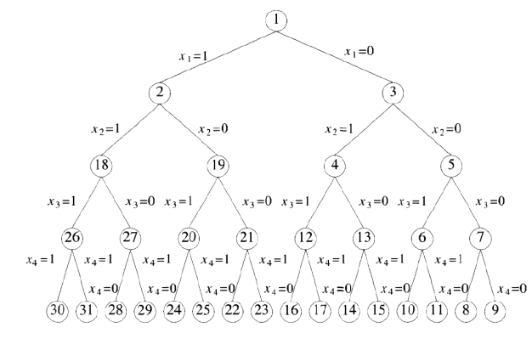
Recursive Solution
We have seen we can represent the solution space in a binary tree.

Slide 5
Recursive Solution
What should we store in each node?
We are concerned with the maximum profit and total weight we have taken.
Let’s store these two properties in each node.
We also need to know the index of the item we are currently processing.
Can we derive a recurrence relation?

Slide 6
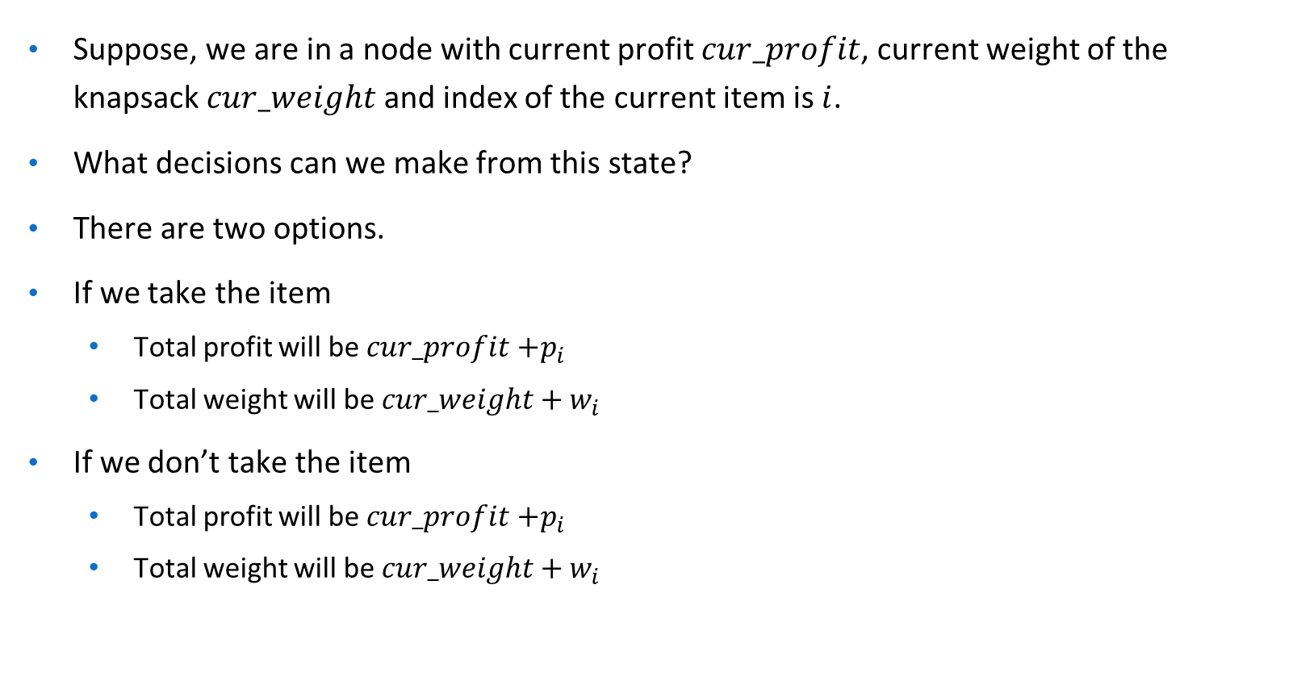
Recursive Solution

Slide 7
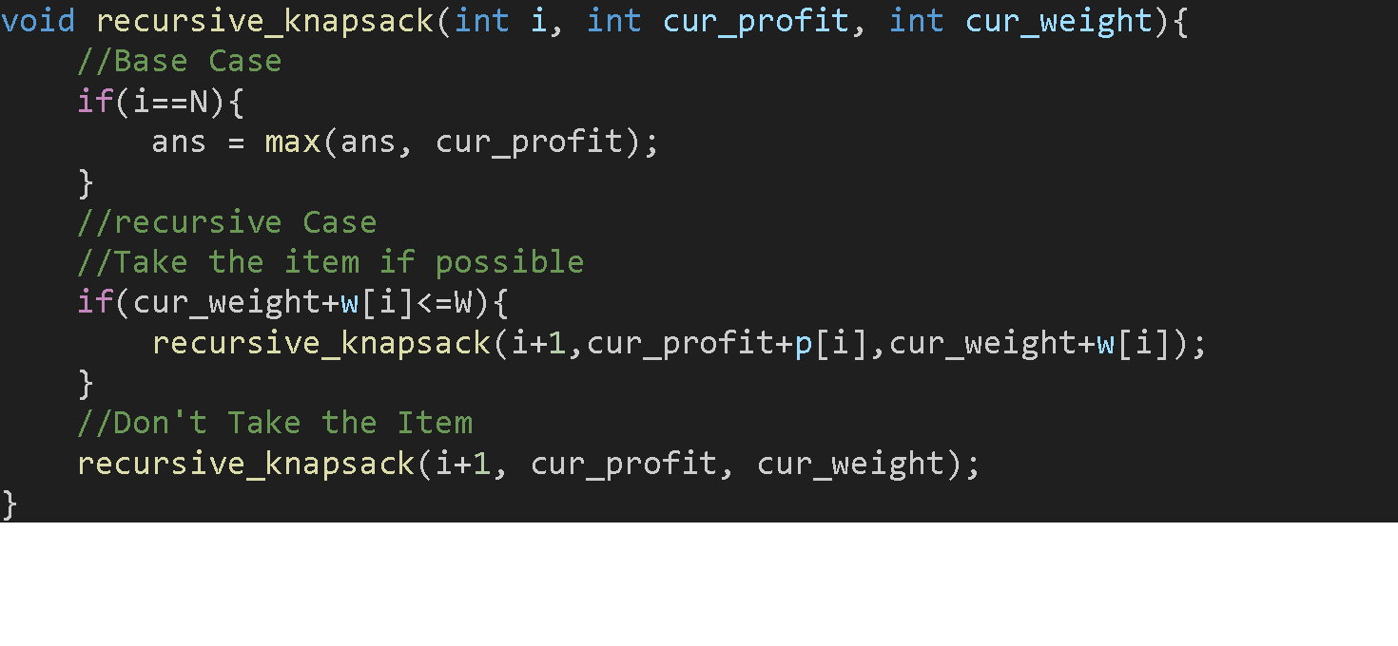
Recursive Solution

Slide 8
Recursive Solution
Let’s modify our recursive solution a little.
As our target is to find maximum profit we will keep it as the return value of the function.
So, each node will store the index of item to process and current weight of the knapsack.
And the node will return the maximum profit we can earn from the subtree of the node.

Slide 9
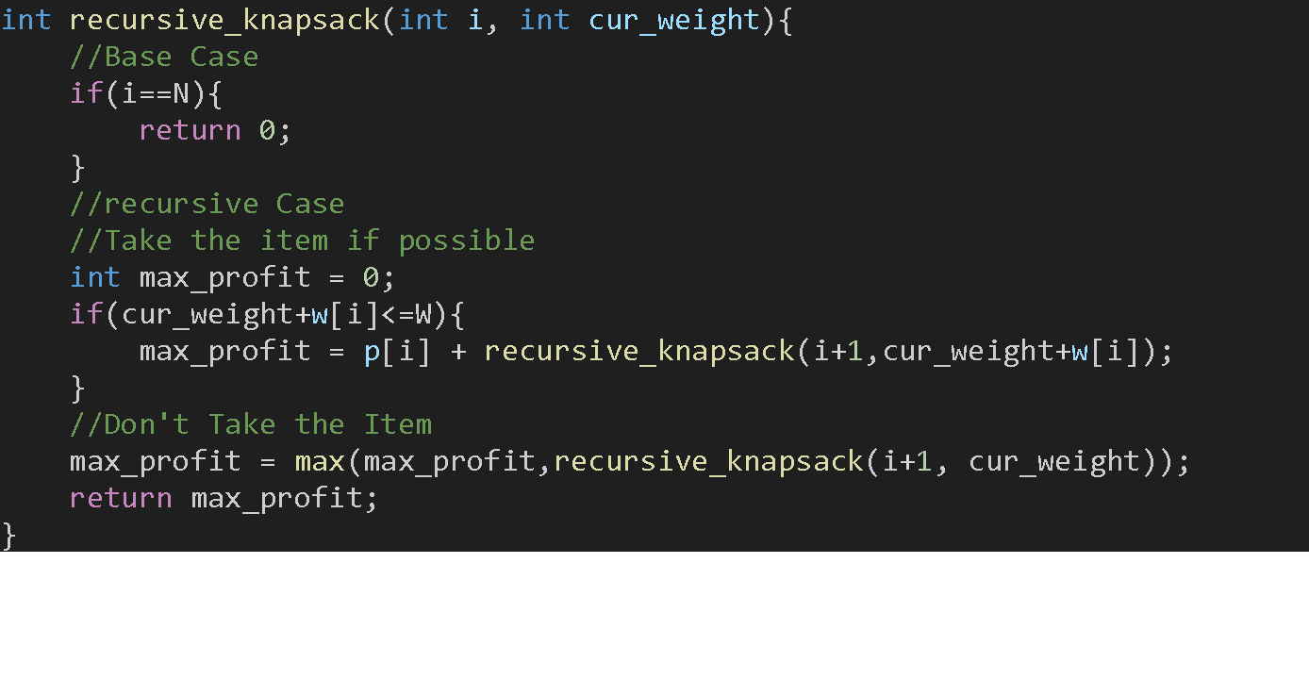
Recursive Solution

Slide 10
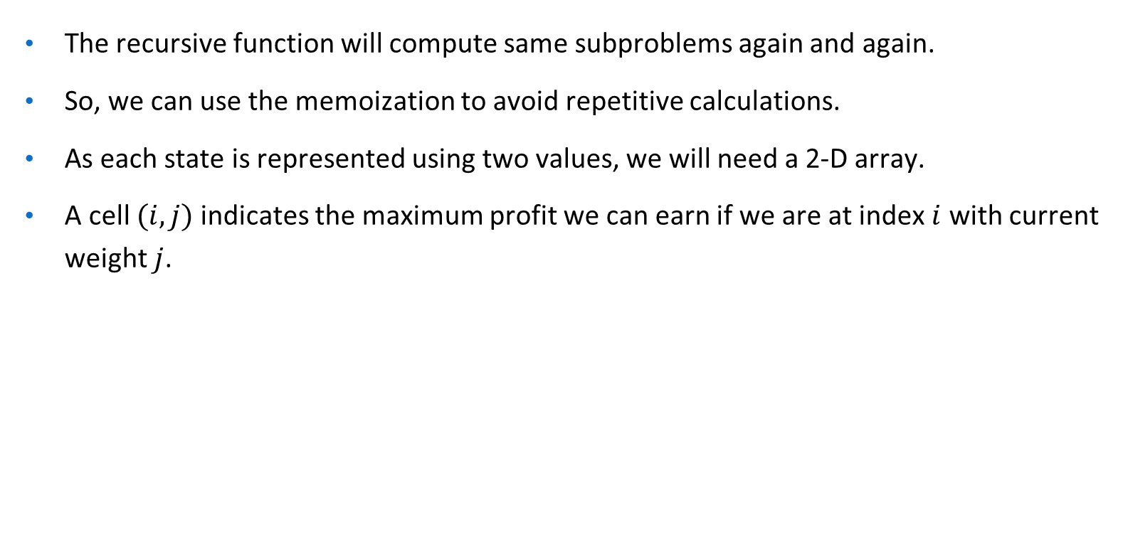
DP Solution

Slide 11
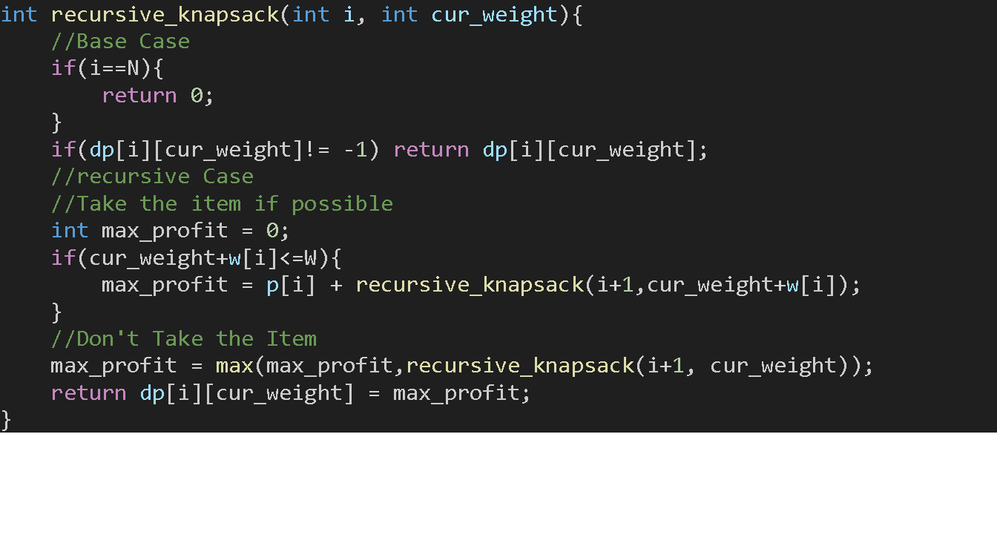
Memoization

Slide 12
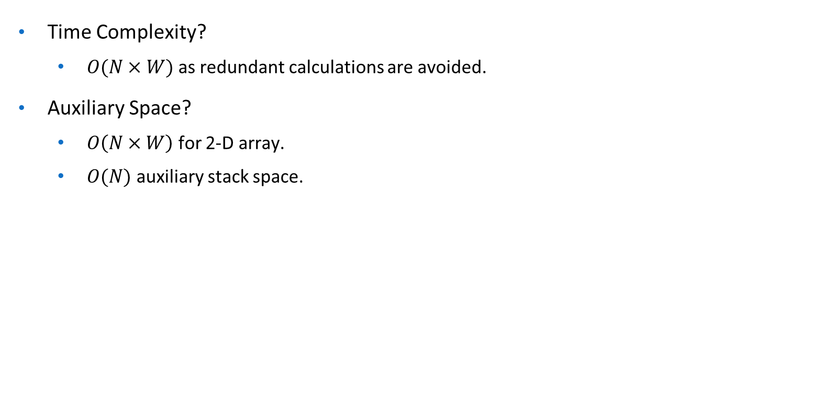
Complexity Analysis

Slide 13
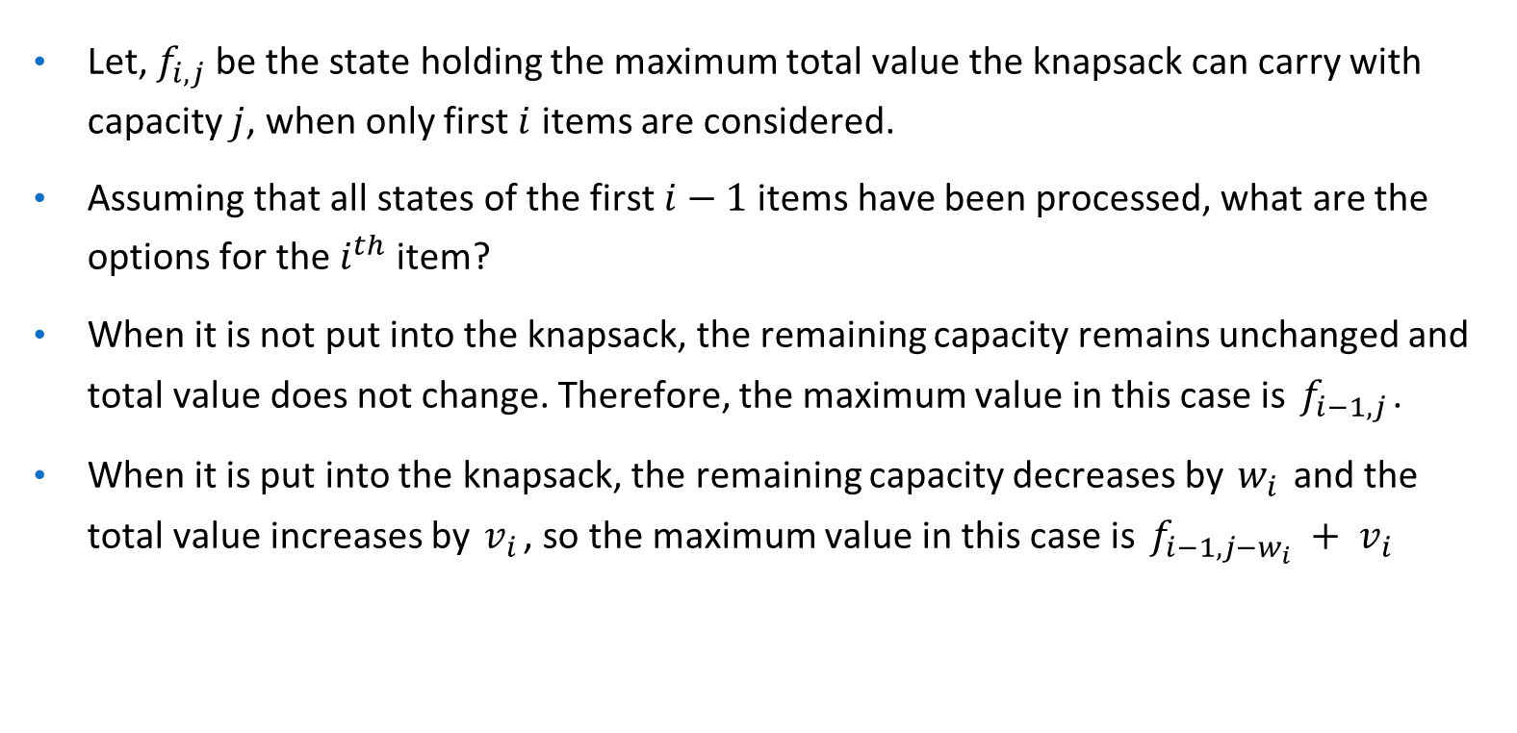
Bottom-up Approach

Slide 14
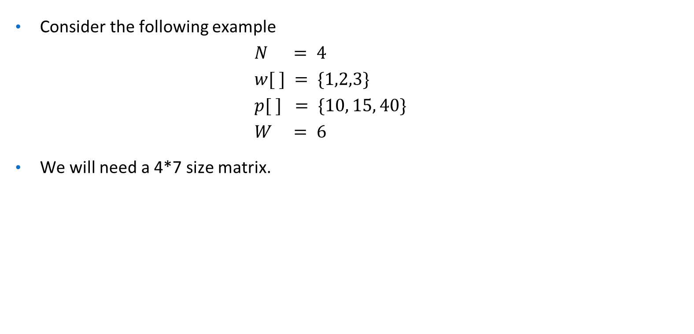
Bottom-up Approach
_{Item} ^{Weight} | 0 | 1 | 2 | 3 | 4 | 5 | 6
0
1
2
3

Slide 15
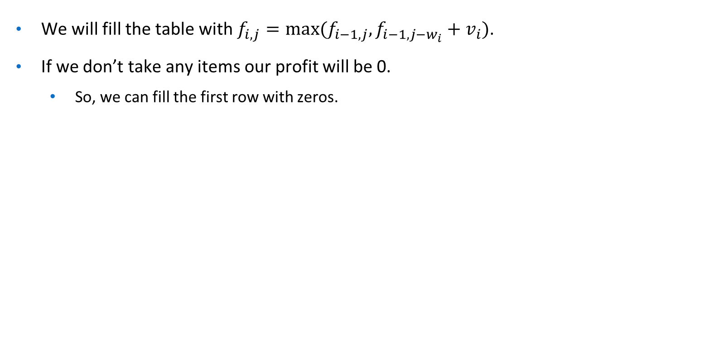
Bottom-up Approach
_{Item} ^{Weight} | 0 | 1 | 2 | 3 | 4 | 5 | 6
0 | 0 | 0 | 0 | 0 | 0 | 0 | 0
1
2
3

Slide 16
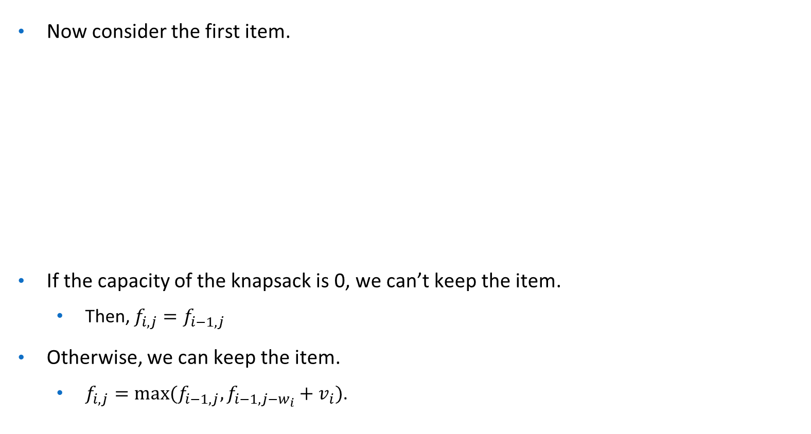
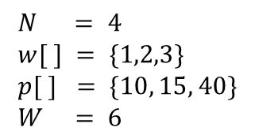
Bottom-up Approach
_{Item} ^{Weight} | 0 | 1 | 2 | 3 | 4 | 5 | 6
0 | 0 | 0 | 0 | 0 | 0 | 0 | 0
1
2
3
0 | 10 | 10 | 10 | 10 | 10 | 10

Slide 17
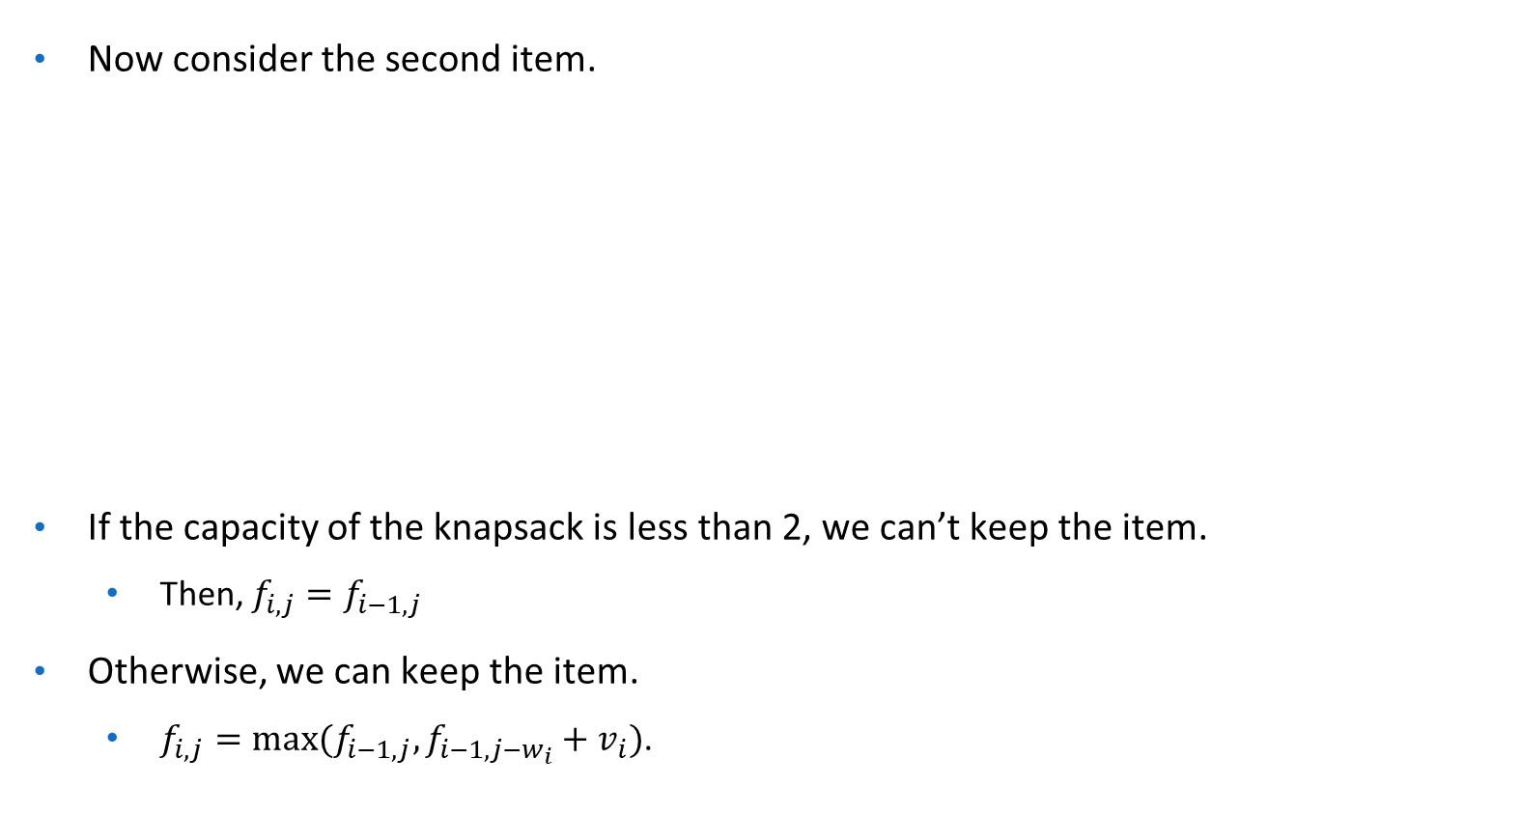
Bottom-up Approach
_{Item} ^{Weight} | 0 | 1 | 2 | 3 | 4 | 5 | 6
0 | 0 | 0 | 0 | 0 | 0 | 0 | 0
1 | 0 | 10 | 10 | 10 | 10 | 10 | 10
2
3
0 | 10

Slide 18
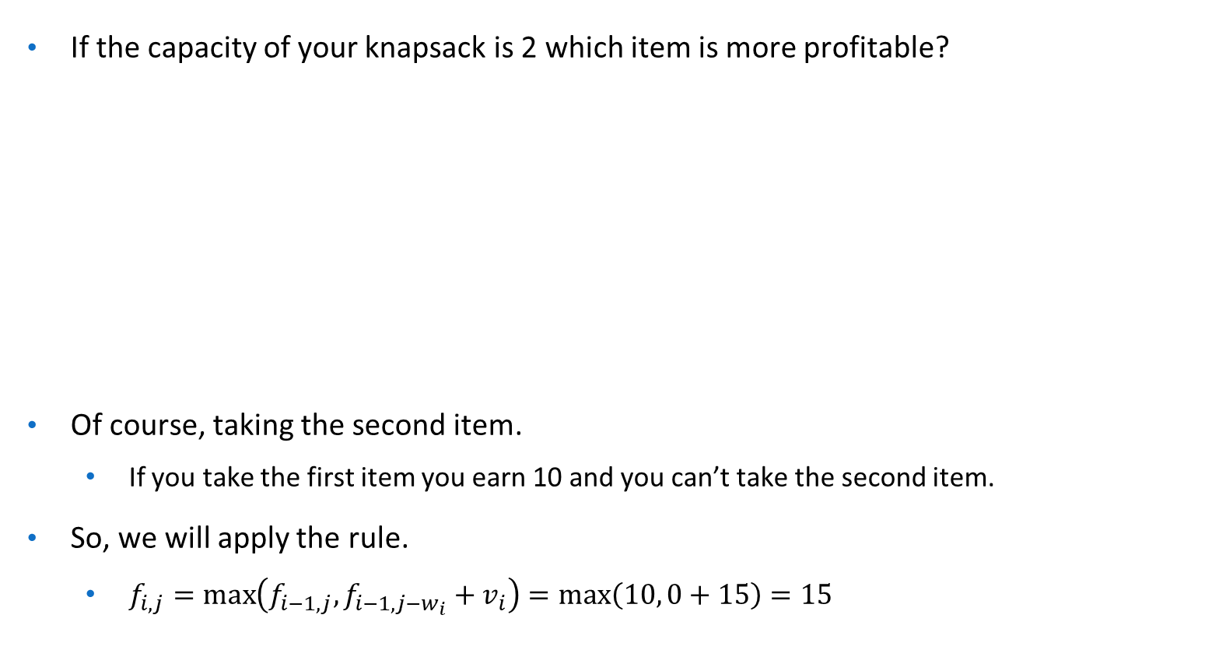
Bottom-up Approach
_{Item} ^{Weight} | 0 | 1 | 2 | 3 | 4 | 5 | 6
0 | 0 | 0 | 0 | 0 | 0 | 0 | 0
1 | 0 | 10 | 10 | 10 | 10 | 10 | 10
2
3
0 | 10
15

Slide 19
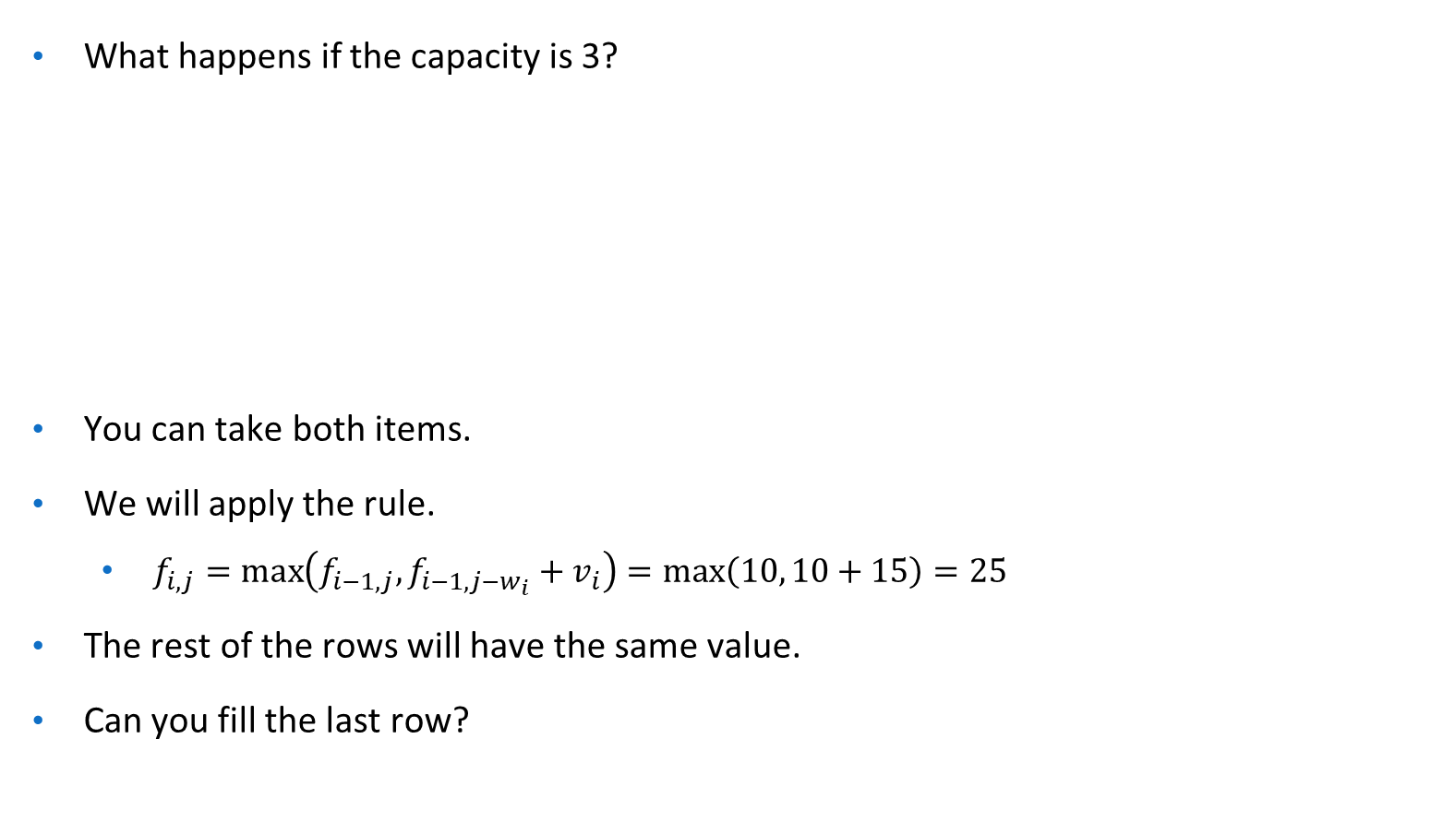
Bottom-up Approach
_{Item} ^{Weight} | 0 | 1 | 2 | 3 | 4 | 5 | 6
0 | 0 | 0 | 0 | 0 | 0 | 0 | 0
1 | 0 | 10 | 10 | 10 | 10 | 10 | 10
2
3
0 | 10
15
25
25 | 25 | 25

Slide 20
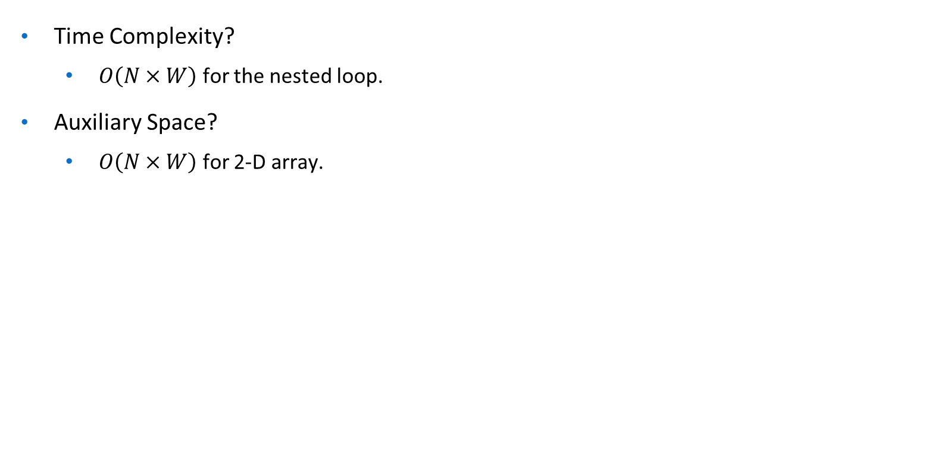
Complexity Analysis

Slide 21
References
Knapsack Problem - Algorithms for Competitive Programming
0/1 Knapsack Problem - GeeksforGeeks
Computer Algorithms
– Ellis Horowitz, Sartaj Sahni, Sanguthevar Rajasekaran.

